Slide 1
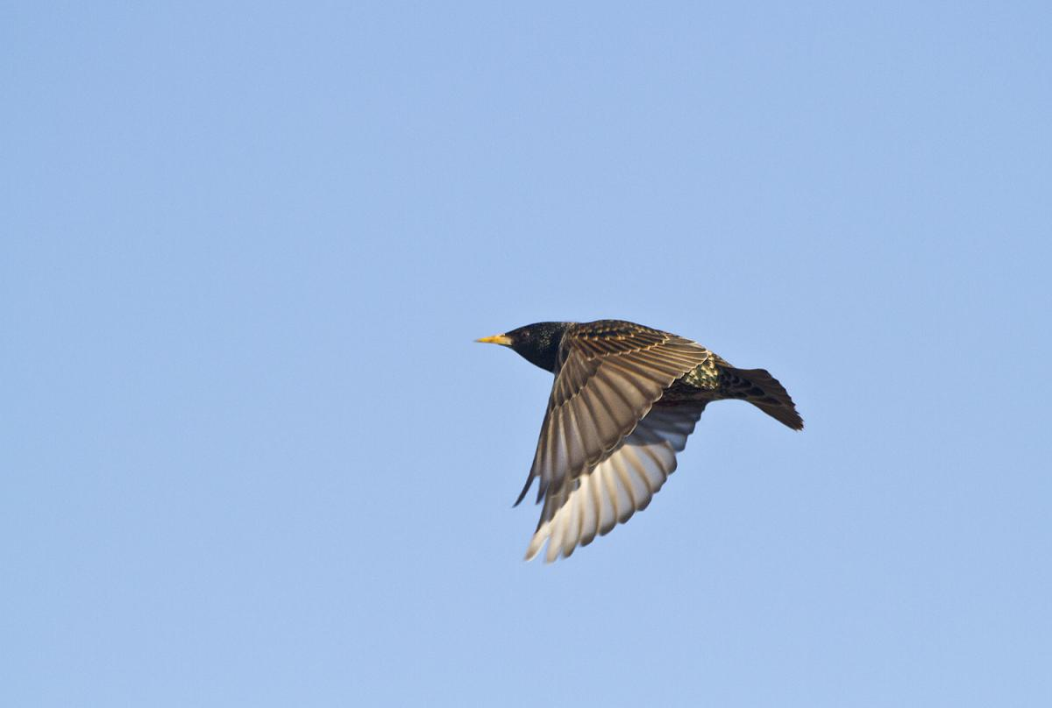
Avian Temporal Occupancy and Climatic Suitability to Determine Core and Transient Species Distributions in the United States
Sara Snell
BIOL 465
12/11/2015

Slide 2
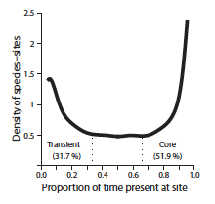
Background
Climatic suitability and avian temporal occupancy
Core species persist in an area over time
Transient species are found in an area occasionally
From Coyle et. al 2013: Probability density distribution of core and transient species occupancies.
Notes:
Linear models to evaluate relationships
Euclidean distance for multivariate analysis of suitability
distinct relative abundances respond to environmental variables as determinants of local richness,

Slide 3
Hypotheses
Core species occur in the center of their geographic range
More successfully predicted by local environmental variables
Climatic determinants are species-dependent
Notes:
Coyle et al 2013, (Hurlbert & Stegen, 2014)
Optimal climate
Shift to transient as climate becomes less suitable
Geographic range to explain species distributions
Visible latitudinal gradient for species with large core habitats²

Slide 4
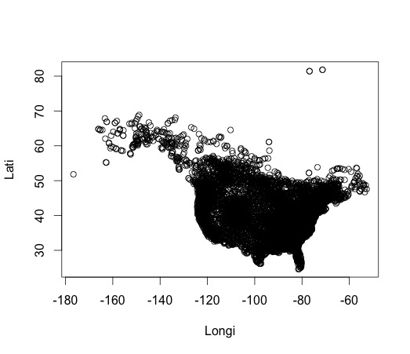
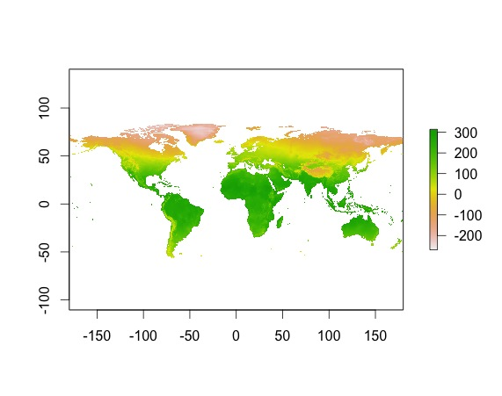
Datasets
Breeding Bird Survey Data (BBS)
Continental USA & part of Canada
Species & state route
Species with > 4 observations
Climatic variables
Temperature
Elevation
Precipitation
EVI
Euclidean distance
Occupancy point data from BBS
Global temperature data in Celcius*10
Notes:
Z-score
Euclidean distance
Univariate and multivariate linear models
Paired t-tests assess which variables explained most variation

Slide 5
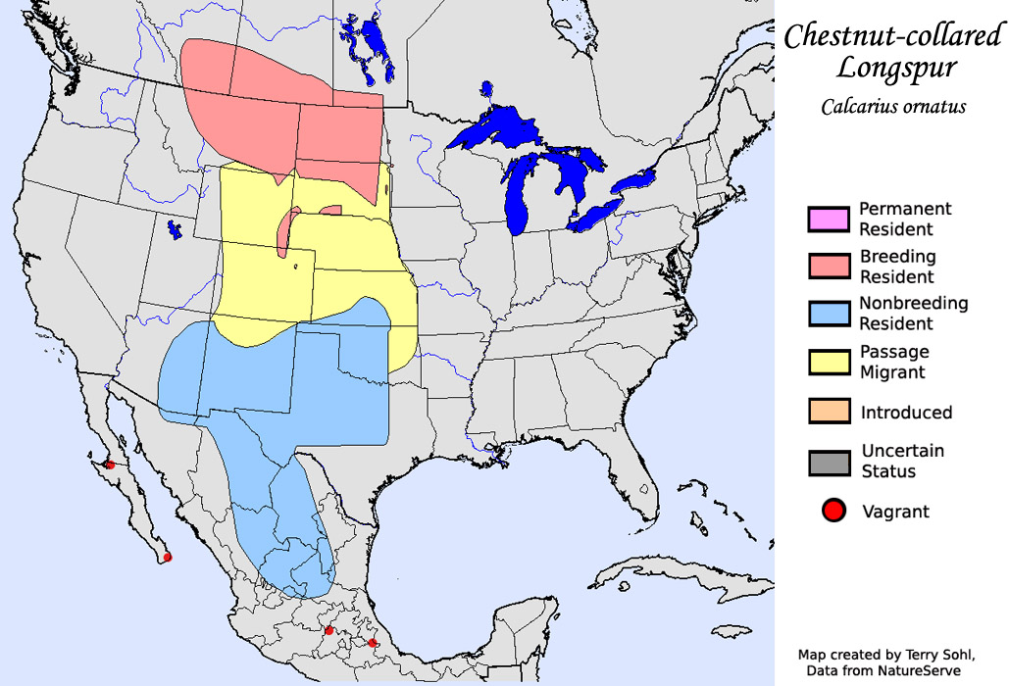
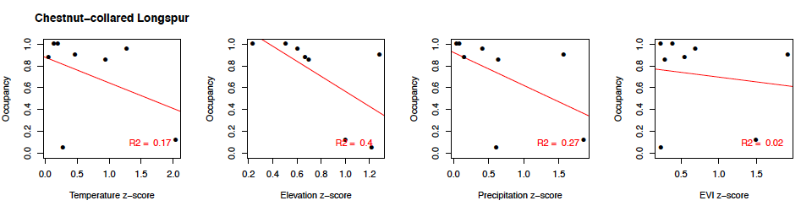
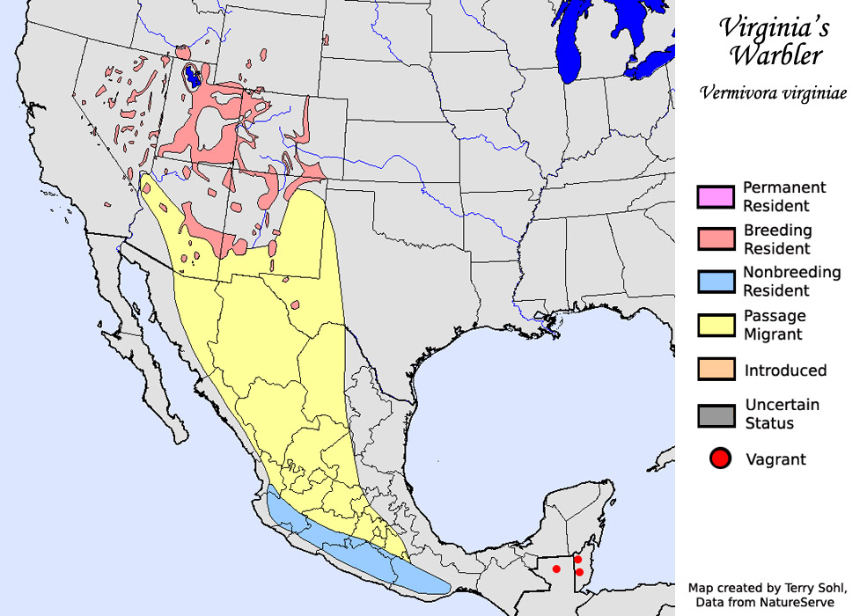
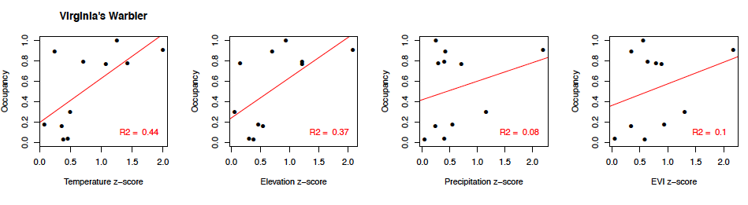
Results
Certain species occupancy predicted by all environmental variables
sdakotabirds.com
Other species occupancy unsuccessfully predicted by all environmental variables
Notes:
Chestnut-collared Longspur occupancy predicted by all environmental variables
Virginia’s warbler occupancy was unsuccessfully predicted

Slide 6
Conclusions
Climatic determinants were species-dependent
Univariate analyses had better predictive power than multivariate
Best predicted: Mid-range species occurring primarily in the continental US
Best predictor: Temperature
Notes:
Difficult to differentiate between core and common species

